Slide 1
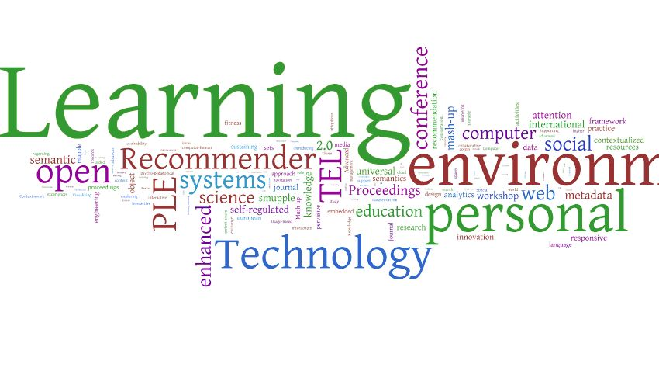
What light does cognitive psychology throw on the doctrine of ‘original sin’?
Revd Dr David Heywood, Tyndale Conference, July 4th, 2024

Slide 2
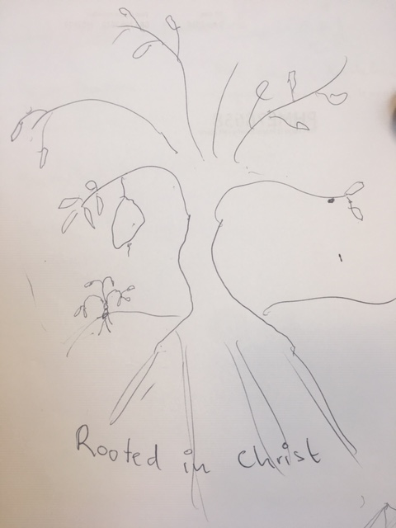
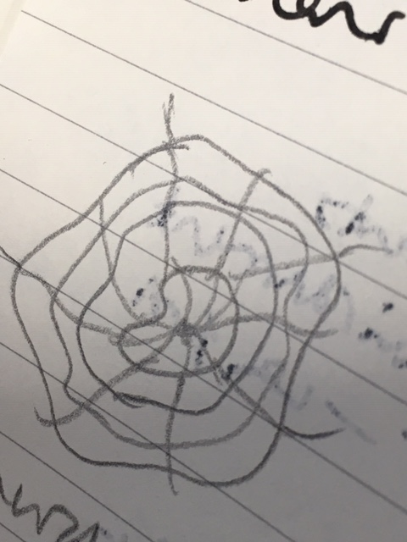
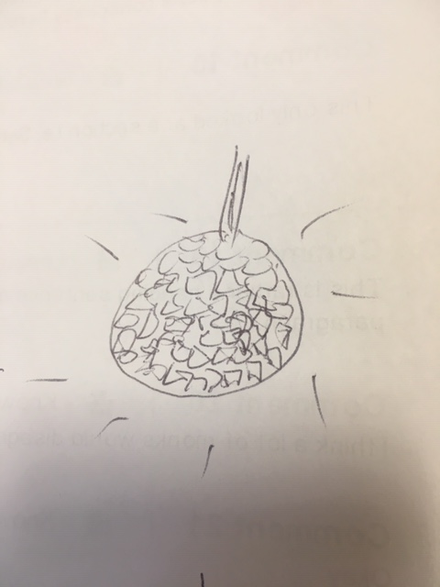
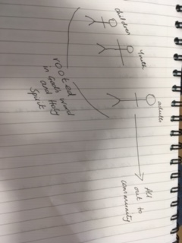
Draw a picture to illustrate your idea of the church
Notes:
There’s an exercise I have used many times over the years to introduce a teaching session about adult learning. I ask students to draw a picture to represent their idea of the church. It can be representative, with pictures of buildings with steeples and so on, diagrammatic, or symbolic, or any combination of these. After a few minutes, I ask them to share their pictures in groups of three and explain them to one another. Having used this exercise on scores of occasions over more than thirty years, two things emerge without fail: all the pictures are different, but when students explain them to each other, all can recognise that they depict the church we all belong to.

Slide 3
Learning about church
C
c
KNOWLEDGE
BELIEFS
OPINIONS
EMOTIONS
VALUES
ATTITUDES
BEHAVIOUR
The church as it exists ‘out there’
The church as I understand it
EXPERIENCE
INTERPRETATION
Notes:
The purpose of the exercise is to demonstrate that cognition and memory are always constructive. There is ‘big C’, the church that is ‘out there’ and we all belong to. And then there is ‘little c’, the church in our heads, our mental model of the church. ‘Little c’ is constantly receiving experience of the church from ‘big C’: worship on Sundays, PCC meetings, articles in magazines, TV depictions of clergy, conferences like this one. And rather than passively taking in this experience, ‘little c’ is interpreting it, using stored information from previous experience to make sense of it.
The congregations we preach to on Sundays, the students who arrive in our classes, are not blank sheets of paper on which to write our own preferred take on the church, or any other subject. They already have a theology of church, consisting of their interpretation of previous experience, and likewise a theology of God, Jesus, atonement, the Bible and anything else you care to name. Moreover, that theology is not confined to the cognitive domain. It includes not only facts and opinions, but feelings, values, attitudes, expectations and patterns of behaviour. At the time of my research in the 1980s, many cognitive scientists were having a hard time coming to terms with the idea that feelings play a crucial part in the way we construe the world, but since then it has been amply demonstrated by the newer discipline of cognitive neuroscience and has become something we are all familiar with.

Slide 4
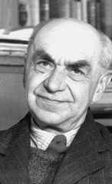
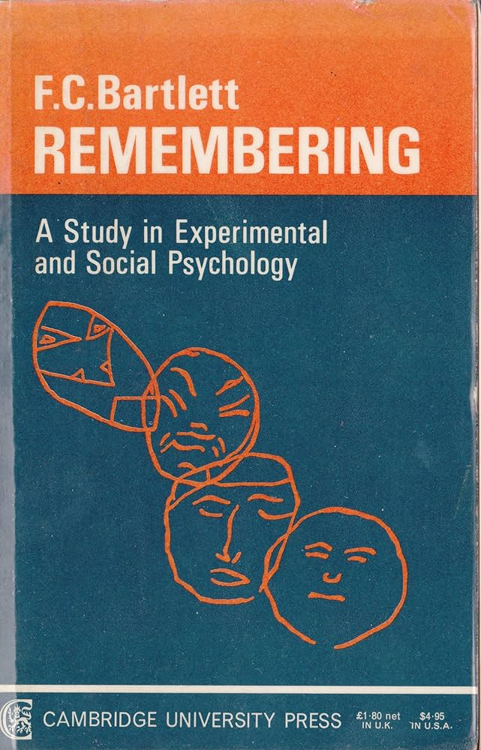
Reconstructive memory
Notes:
One of the developments at that time was that cognitive scientists were rediscovering the work of Sir Frederic Bartlett in the 1920s, summarised in his book Remembering (Cambridge University Press, 1932). Bartlett used a series of experiments to show that memory is reconstructive. He showed people a picture of a sign by a gate with some garbled writing on it, and found that most people remembered it as saying, ‘Trespassers will be prosecuted.’ He showed them an ill-defined pattern of lines with the label, ‘An Airoplaxe’ – A-I-R-O-P-L-A-X-E – and 19 out of 20 remembered it as, ‘an aeroplane.’ He told subjects a story called the ‘War of the Ghosts’, which featured native Americans and a strange and supernatural ending, and tested their recall of the story after 15 minutes, a few hours, the next day, the next week, and so on. In almost all cases, they made sense of the story by framing it in a way that was familiar from their own experience, or they latched on to one memorable aspect of the story and made up the rest of the story to fit.
Bartlett christened the structures of our memory ‘schemas’ (or ‘schemata’, to use the strictly correct plural) and this was taken up into cognitive science. They are now often called ‘semantic networks’. Schemas or semantic networks are structuring structures. They consist of active expectations for a given situation based on past experience, which then interprets present experience, telling us how to think, feel and behave. At this moment, you are deploying your schemas to make sense of what I am telling you and fit it in with what you already know, and if some of it is new, outside your previous experience, you are using the schema that provides the closest analogy to it. And as you do this, there is dialectic relationship in play. Without deploying your expectations of what you might be going to hear, based on the schemas of your memory, you couldn’t understand anything at all, but at the same time your expectations must always leave room for something new and unexpected. And this is a feat that all human beings are able to achieve, some better than others but all to some extent.
I’ll pause at this point to reassure you that I have not lost sight of the main point of this paper and the theme of our conference. The evidence is overwhelming that cognition is constructive, and my suggestion is that this fact is the key to understanding the idea of original sin. We all construct our own worlds, we all do so from a centre in ourselves, and we have no alternative but to make ourselves the centre. To establish this, we will be making a journey from social science into philosophy and ending up with theology.

Slide 5
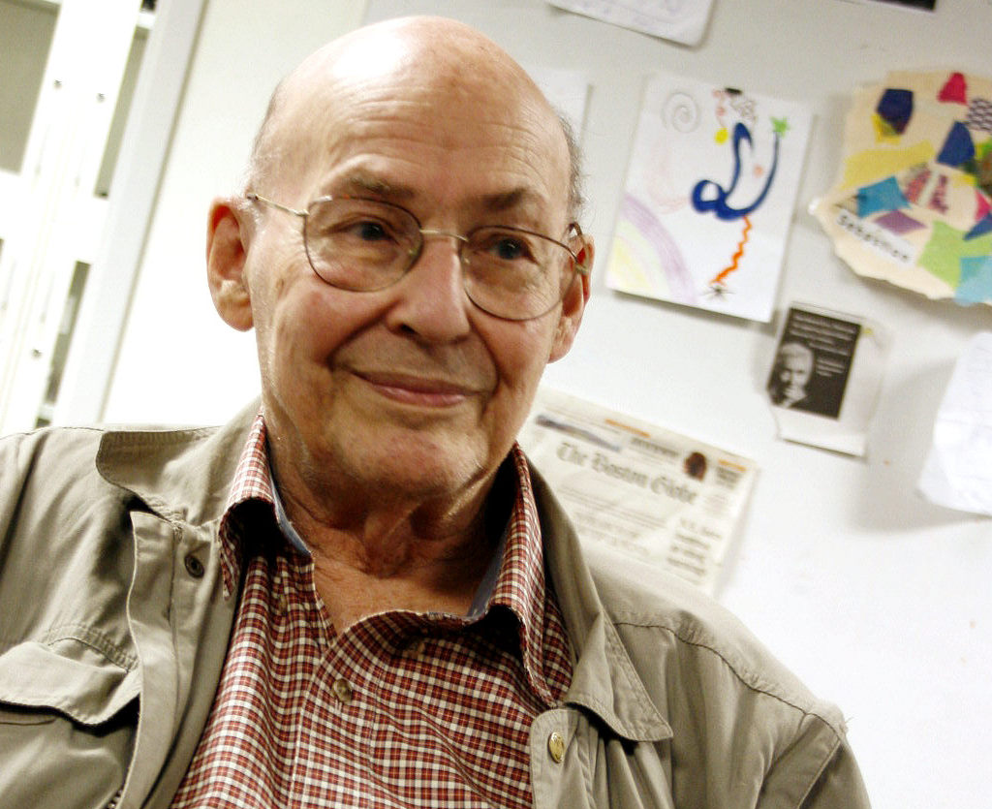
Naturalistic v teleological explanation
‘Computers made of meat’
Notes:
The idea that cognition and memory are constructive strongly implies that human beings are agents with purposes. But this is a position that is resisted in many branches of the social sciences. It means that, while practical theologians must engage with the social sciences, we don’t have to accept their philosophical positions. All social sciences are undergirded by an assumed anthropology, the case of cognitive science the image of humans as information processors. But in my experience, many social scientists fail to recognise that their assumed anthropology is just that and jump to the conclusion that it is an unassailable description of reality. A famous example is Marvin Minsky of MIT, who declared that human beings are, ‘computers made of meat.’
Naturalistic explanations tend to be preferred, and this often results in the coining of euphemisms for human purpose, such as the ‘motivational need-state of the organism’ (Paul Barber and David Legge, Perception and Information, London: Methuen, 1976, p.82-83).

Slide 6
Selective attention
Notes:
There is a telling example in the field of selective attention. This concerns what was called the ‘cocktail party phenomenon’, the question of how we are able to pick out just those things we want to hear against the background of conversation in a crowded room, and why, when someone nearby mentions our name, our favourite football team or something else that closely concerns us, our attention is immediately diverted from the person we are listening to.
Until the 1970s, all the favoured explanations involved some kind of mechanism between the ear and the brain. But in 1973, Neville Moray put forward a different explanation based on the experience of airline pilots. Rather than passively receiving information, the pilot is actively doing something, scanning her instruments for the information she needs. She is also deploying a schema that tells her how important the information she is receiving is at any given moment, and constantly updating the schema according to conditions. Moray’s explanation is of a totally different kind from the hypothetical mechanism school. It is teleological rather than naturalistic, and for this reason, it was almost totally ignored. If you look up selective attention on Wikipedia, you will still find a parade of hypothetical natural mechanisms.

Slide 7
The role of the self
Learning about the world and learning about the self are two sides of the same coin.
Notes:
The important thing for our purposes is that selective attention reveals the role of salience and the self in cognition. If we are actively scanning the conversations going on around us, it is for things that are salient: important to us. In other words, our understanding of ourselves, our self-schema is engaged. There is another field, cognitive dissonance, which also reveals the importance of the self-schema in cognition, but unfortunately there is not time to develop this here. Suffice it to say that our concept of self is constantly and continually involved in cognition: each time we learn something new about the world, we also make a judgement about how it relates to ourselves; learning about the world and learning about the self are two sides of the same coin.
What this means is that the self-schema is also a construction. It is the way we have learned to think about ourselves based on our experience. Moreover, the way we have learned to think about ourselves, and the way we want others to think about us, is of vital importance to us. The self-schema is involved in all our acts of cognition and forms the centre of our mental model of the world.

Slide 8
Who am ‘I’?
Teleological rather than naturalistic explanation
Existence of a knowing subject
Which cannot be known directly
Notes:
Having arrived at this conclusion, it is time first to examine the philosophical assumptions required to support it, and then to bring in theology as interpreter. There are three major assumptions I think we need to make if we are to make sense of the data that I have cited – and much, much more that I have had to leave out.
We need a broader anthropology than simply the idea of human beings as information processors or cognition consisting of a series of mechanisms. We need to think of human beings as agents with purposes. In other words, we plump for teleological rather than naturalistic explanation.
If we create our world models, including our models of ourselves, through interpretation of experience, there has to be an interpreter, a knowing subject, an ‘I’ who is actually doing the interpreting and constructing.
But this ‘I’, the knowing subject, cannot become the object of direct knowledge. We can only know it indirectly via the self-schema, which may be wrong. Hence, the existential question, ‘Who am I really?’ lies at the back of all experience.

Slide 9
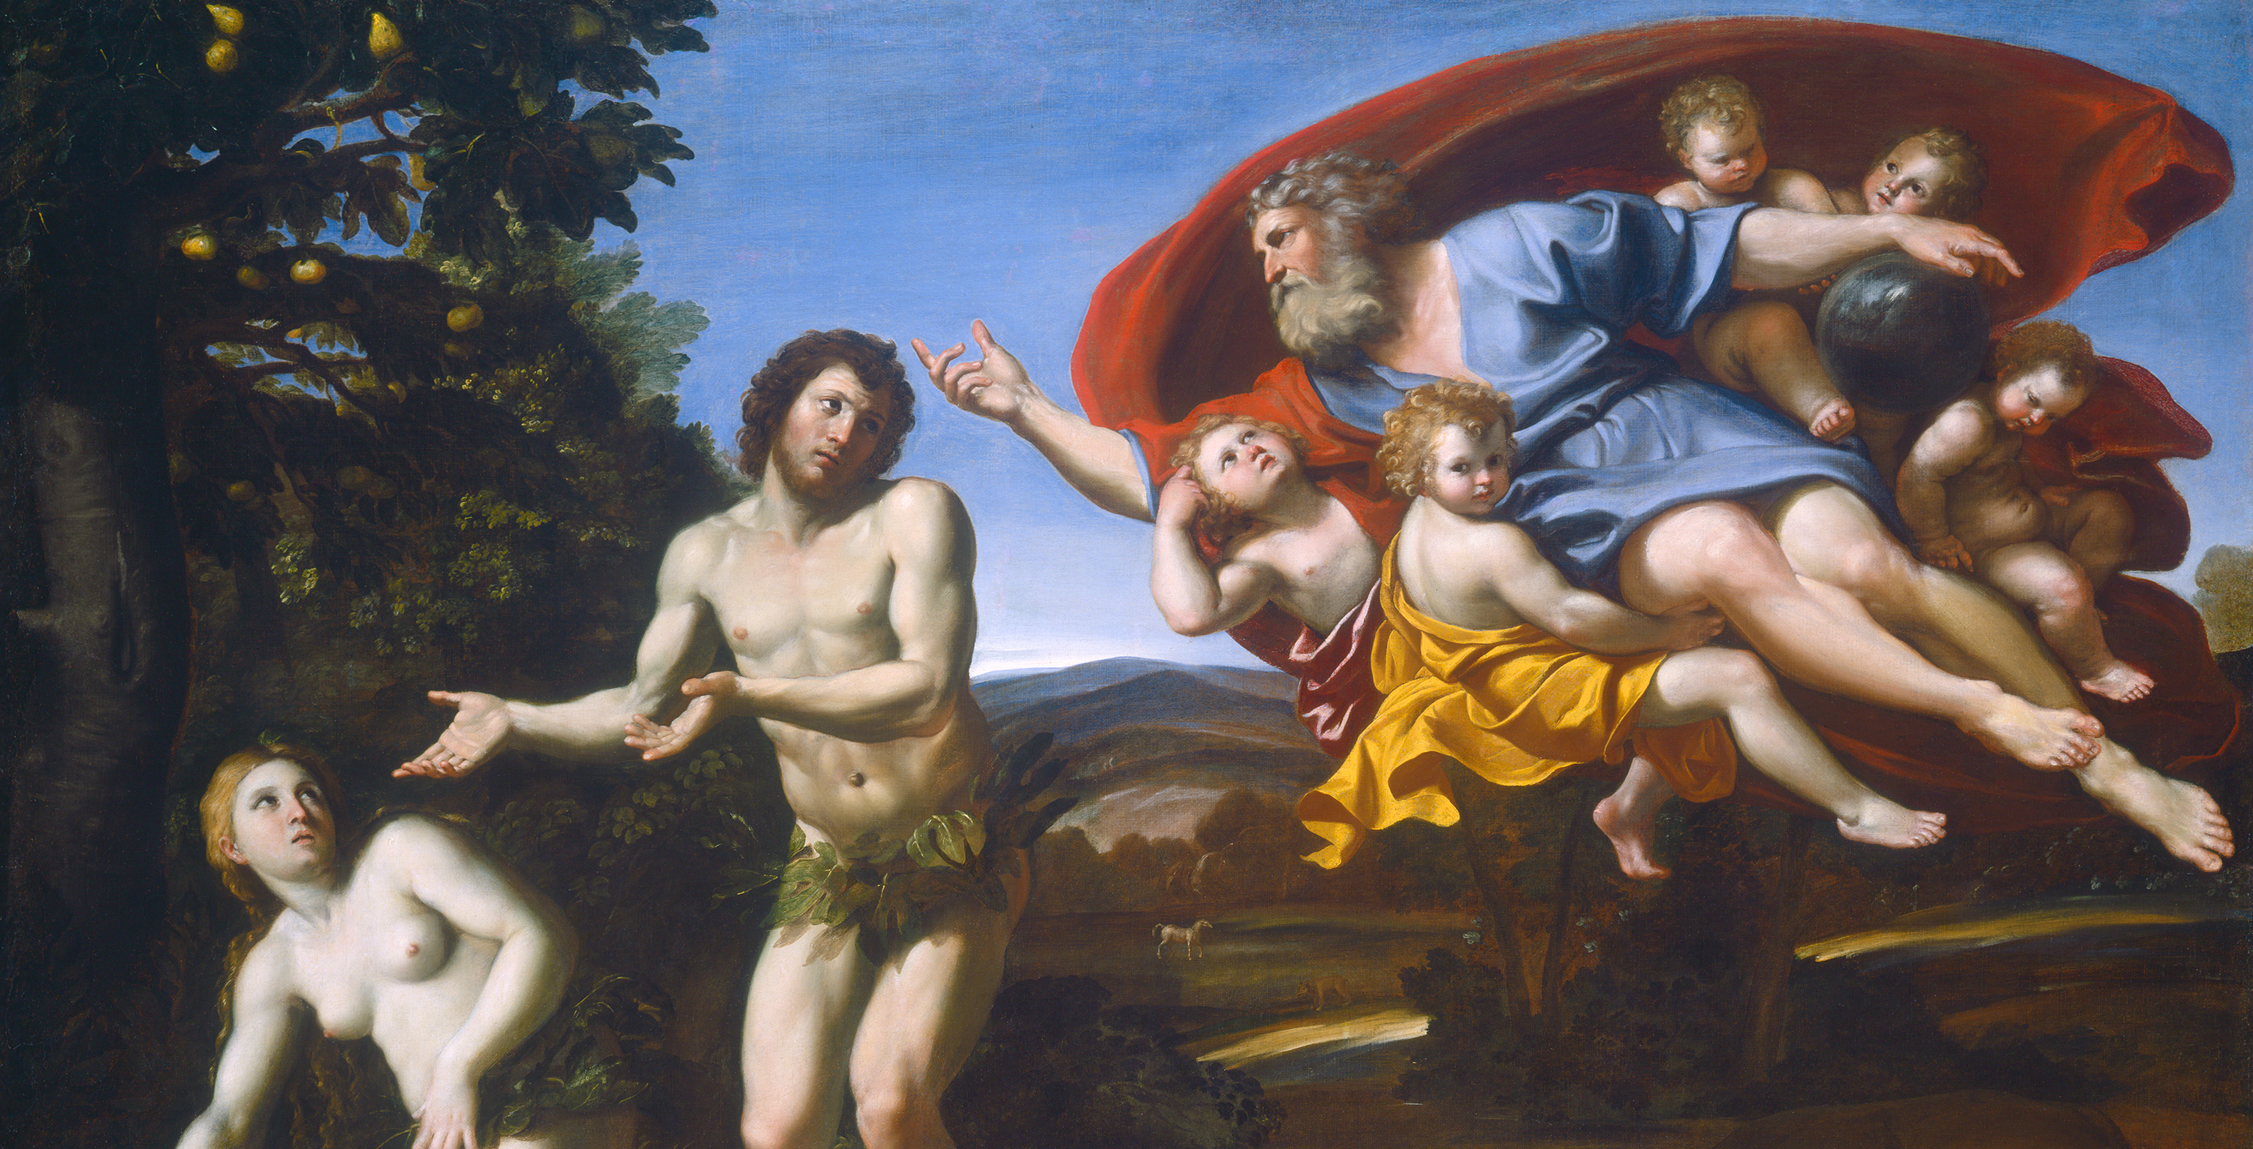
Domenichino: The Rebuke of Adam and Eve, 1626
Notes:
It would be disingenuous to claim that this choice of a philosophical stance is not informed by theology, although all three of these positions has independent philosophical roots and credentials unaffected by theology. But if you will accept them, then we have arrived at the conclusion that we are constrained to construct our understanding of the world and of ourselves from a centre in the self, and that we don’t know who that self actually is. Our sense of value and significance is at the mercy of our experience, moulded as it is in large part by the opinions and responses of others. And this, I am suggesting, is what it means to talk about the world as a whole and each individual person being born into a state of ‘original sin’.
Christian theology tells us that this state of affairs exists because our relationship with God is broken. How could we come to know the truth about ourselves unless we are told by the one who created us? How could we come to love and value ourselves unless we receive love and value from others and ultimately from the one who created us in love?

Slide 10
When we cry ‘Abba, Father,’ it is the Holy Spirit bearing witness with our spirits that we are children of God.
Romans 8:16
What no eye has seen, nor ear heard, nor the human heart conceived, God has prepared for those who love him.
I Corinthians 2:9
Notes:
But Christian theology tells us that this is exactly what has happened. The truth about who we are has been revealed, firstly in the Bible and then pre-eminently in the ministry of Jesus. And this truth is made existentially available to us through the gift of the Holy Spirit, who is the gift of a new identity after the model of Jesus. It is the Spirit who witnesses, ‘with our spirit that we are children of God’ (Romans 8:16), the Spirit who reveals to us, ‘what no eye has seen, nor ear heard, nor the human heart conceived,’ the things, ‘God has prepared for those who love him’ (1 Corinthians 2:9).

Slide 11
Be transformed!
Emil Frei stained glass at St Pius V church, St Louis, MO by hickory Hardscrabble on Flickr
Notes:
The Spirit’s role is to transform us into the people God always meant us to be, ‘from one degree of glory to another’ (2 Corinthians 3:18). In cognitive terms, as divine wisdom, she offers us the possibility of reconstructing our mental model of the world around a centre in God. But because the Spirit is given at the deepest level of our makeup, the human spirit, our understanding of who we really are in relation to God is given as tacit knowledge. It is the knowing that in Michael Polanyi’s words is, ‘more than we can tell’ (The Tacit Dimension, London: Routledge and Kegan Paul, 1967, p.4). The tacit awareness the Spirit brings needs to be worked out in practice before it becomes operational. We need to be ‘transformed by the renewal of the mind’ (Romans 12:2), remembering that the word ‘mind’ here means more than merely thinking, but embraces all the elements involved in cognition: thinking, feeling, valuing, behaving.

Slide 12
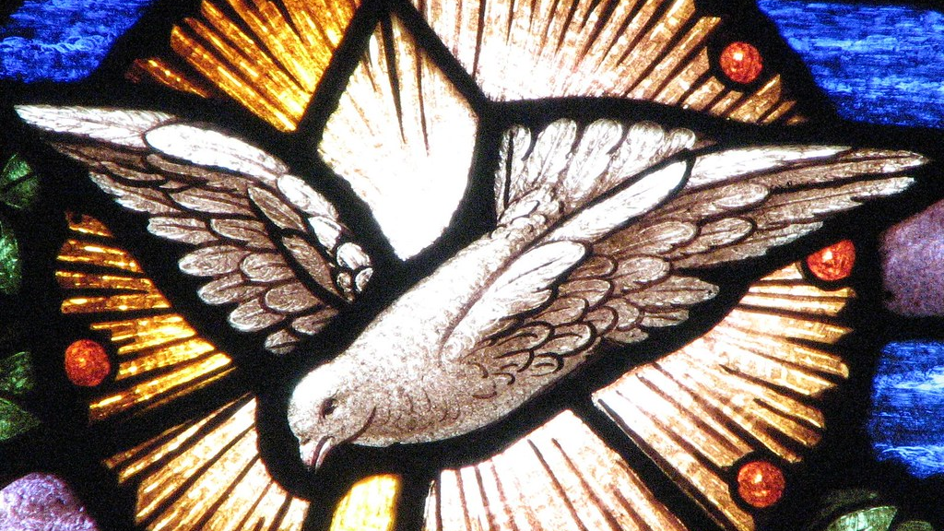
May you be filled with the knowledge of God’s will in all spiritual wisdom and understanding, so that you may lead lives worthy of the Lord, fully pleasing to him, as you bear fruit in every good work and as you grow in the knowledge of God.
Colossians 1:9-10
Notes:
In Colossians 1, Paul prays that the Christians in Colossae will be, ‘filled with the knowledge of God’s will in all spiritual wisdom and understanding, so that you may lead lives worthy of the Lord, fully pleasing to him, as you bear fruit in every good work and as you grow in the knowledge of God’ (Colossians 1:9-10). Here we see that knowing and responding are inextricably linked: knowledge is practical. Discerning God’s will leads to transformed lives, which leads to further and deeper knowledge of God. If original sin consists of a deficiency in knowledge – the knowledge of who we are in relation to God and one another, then salvation consists also in a type of knowledge, the knowledge revealed to us in Jesus and made available to us by the Spirit. And this suggests that there is no sharp distinction to be made between revelation, justification and sanctification. All are part of the one process by which God rescues us from sin and sets us free to become who we are meant to be.

Slide 13
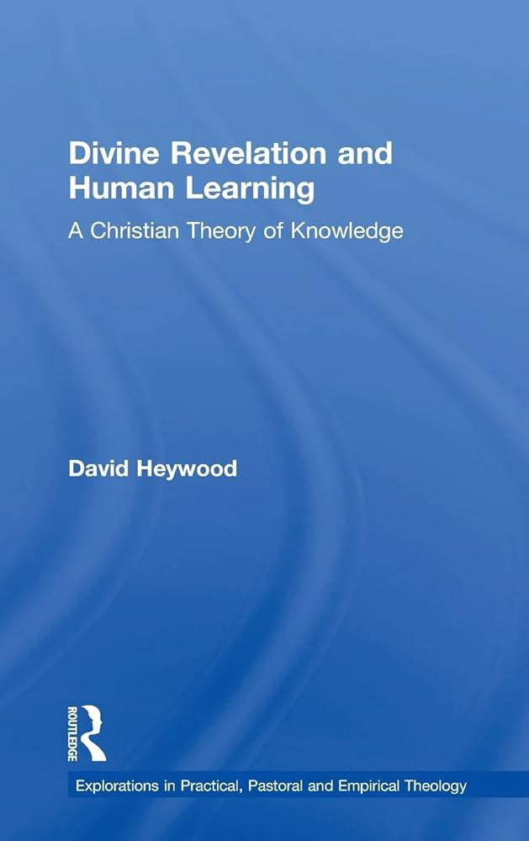
Original thesis at https://www.davidheywood.org/home-page/thesis/

